Slide 1
Welcome
Notes:
X- Welcome to our Parents, carers and families Digital Safety information session.
X – We are going to give you some top tips for yourself and to support your child or children.

Slide 2
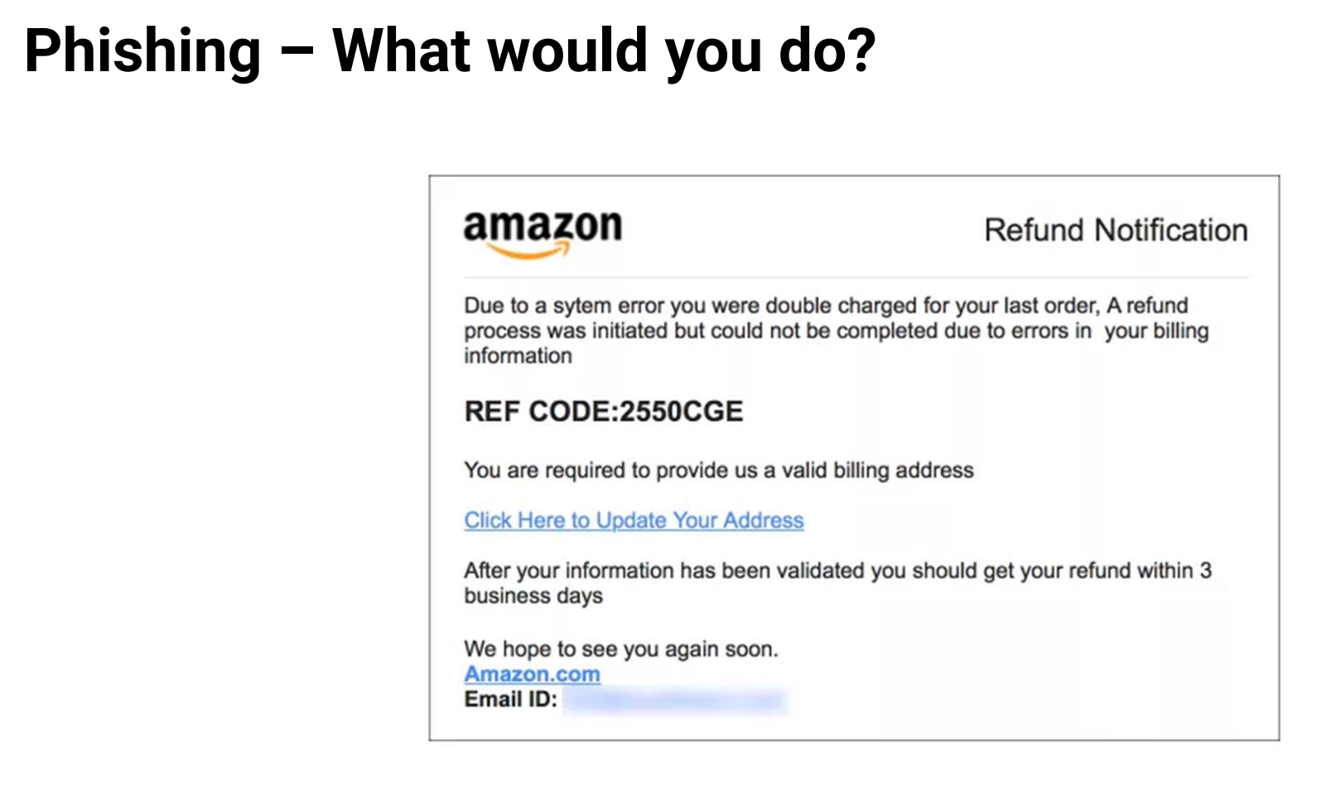
Notes:
X – Has anyone ever received an email like this? This is called phishing. What would you do with this email?

Slide 3
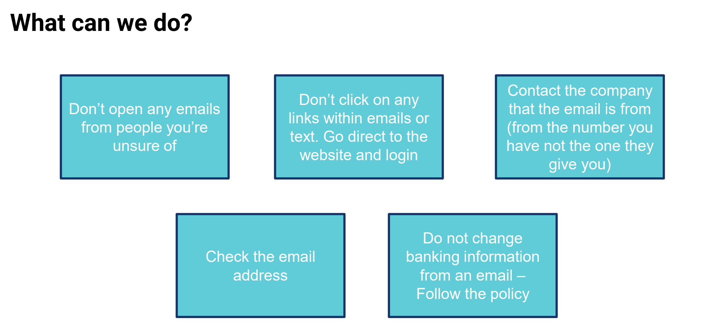
Notes:
X- Please read these top tips and remember:
Do not click on any links
Block the sender
Report the email
Delete the email

Slide 4
Notes:
X – We are now going to tell you about password security. Passwords should be strong and not easy to guess. Are you ready to play a game?

Slide 5
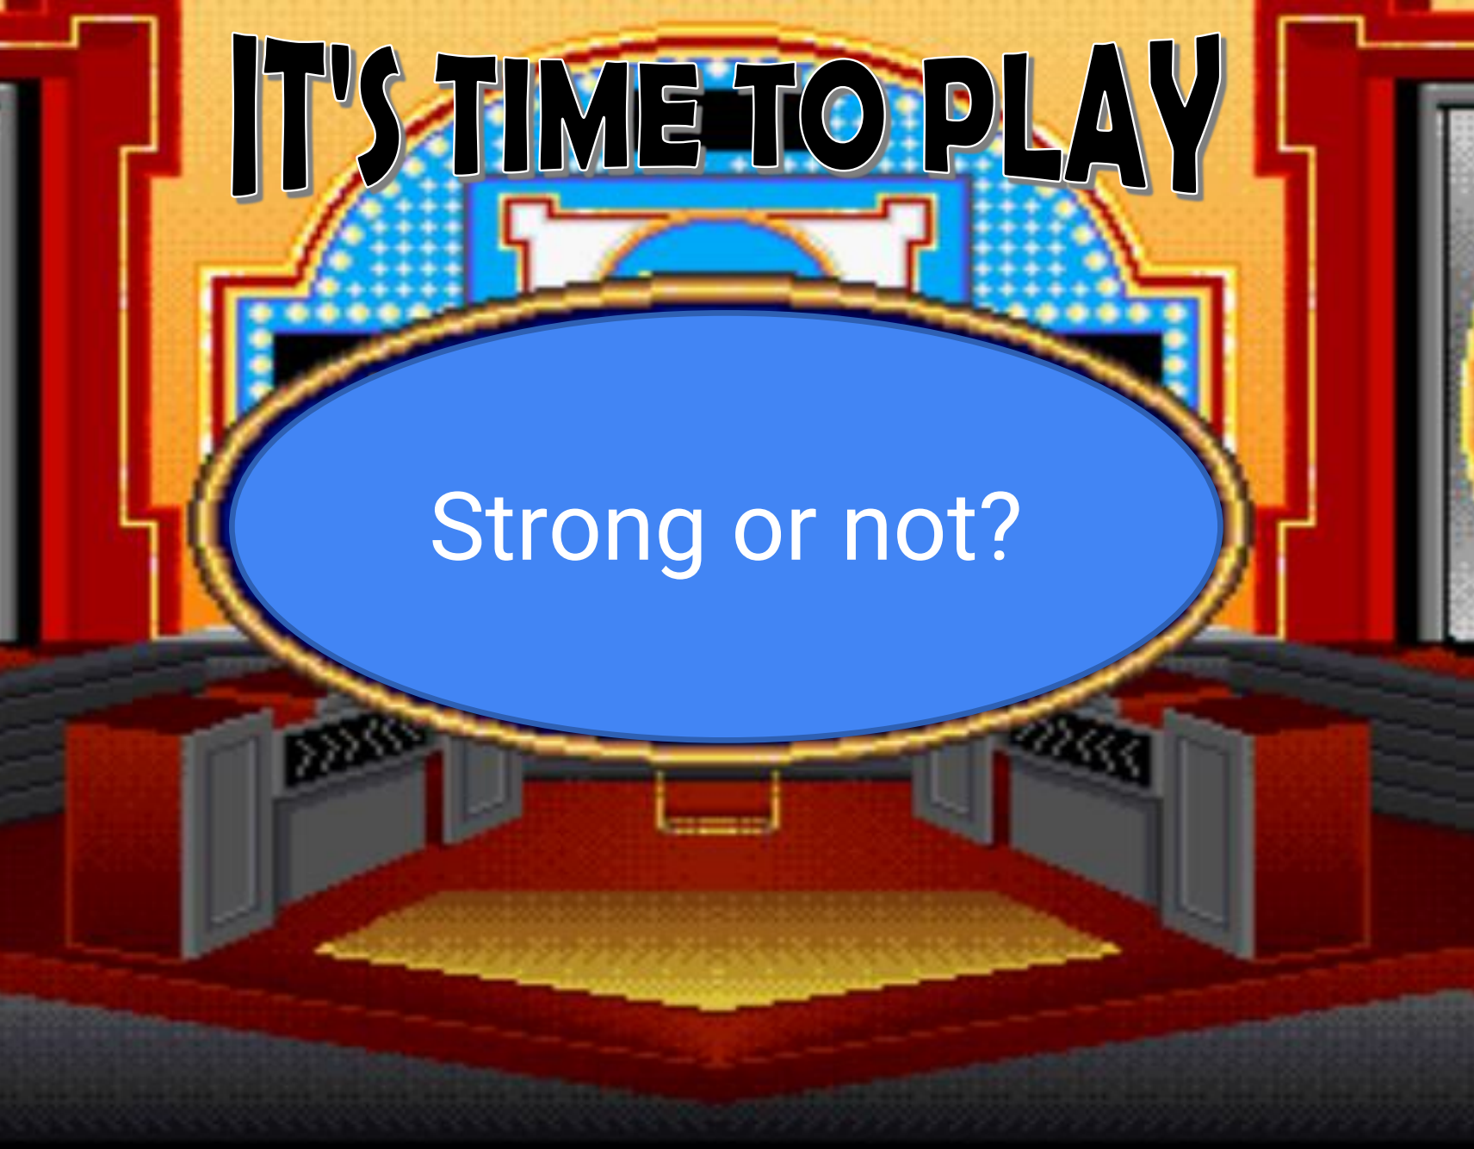
Notes:
X – The game is called strong or not. You need to hold up the correct poster when we show you a password, please.

Slide 6
rebecca123
Notes:
All – Strong or not?

Slide 7
x1@Rebecca@9x
Notes:
All - Strong or not?

Slide 8
password
Notes:
All – Strong or not

Slide 9
@!re6ecca@!
Notes:
All – Strong or not

Slide 10
How Secure Is My Password? | Password Strength Checker | Security.org
Notes:
X – This is a useful website if you would like to check how strong your password is. We will send this PowerPoint out so you have the link.

Slide 11
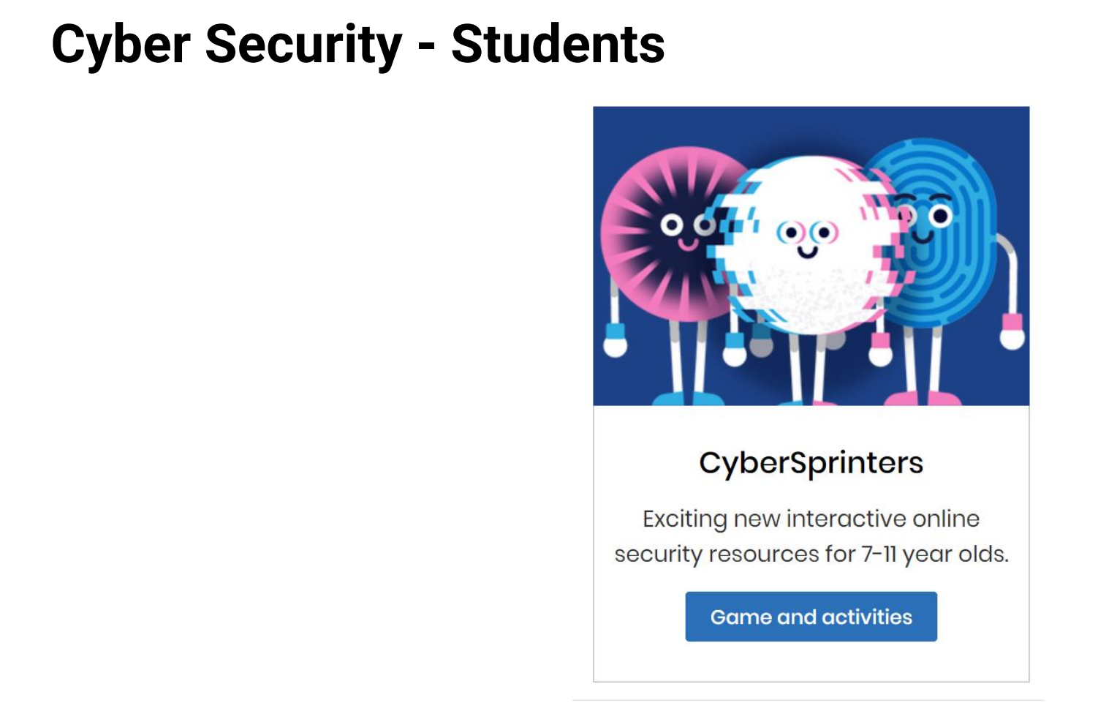
CyberSprinters - NCSC.GOV.UK
Notes:
X– Here is a game that we play in school to help us learn about cyber security. You can play this at home too – it is free of charge.

Slide 12
Notes:
X – The government has a useful website on how to stay safe online. We have put the link here for you.

Slide 13
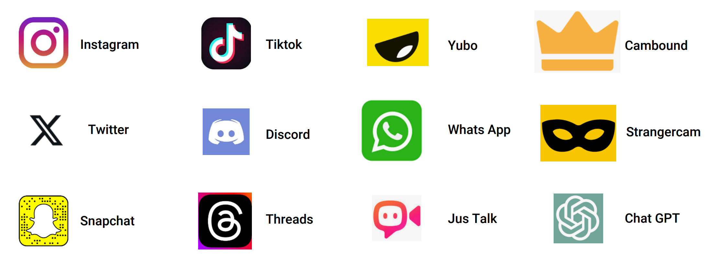
How many social media sites can you name?
Notes:
How many social media sites can you name? Please write them on the plain piece of paper on your tables.
There are so many more out there that we may not know about.

Slide 14
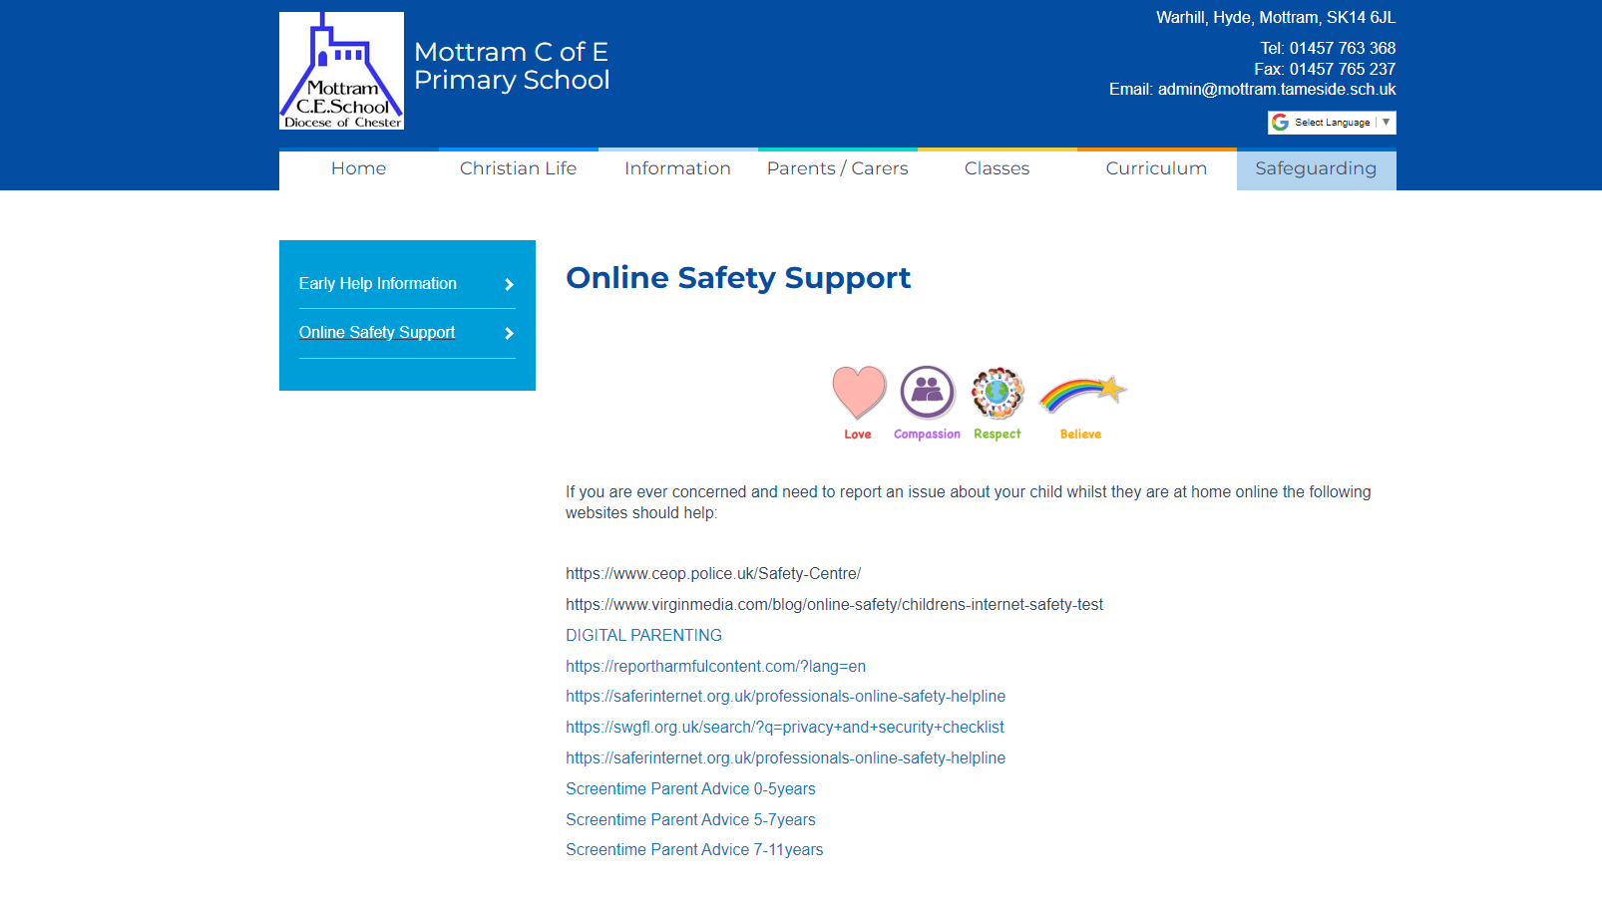
Notes:
Our school website has the age restriction links for the social media sites and other useful websites.

Slide 15
Thank you to our Digital Champions ☺
Notes:
Thank you for listening to us, the digital champions.

Slide 16
Red Class Performance

Slide 17
The next few slides include important information for adults only. The information has not been shared with the children. Video links are accurate on 08.02.24.

Slide 18
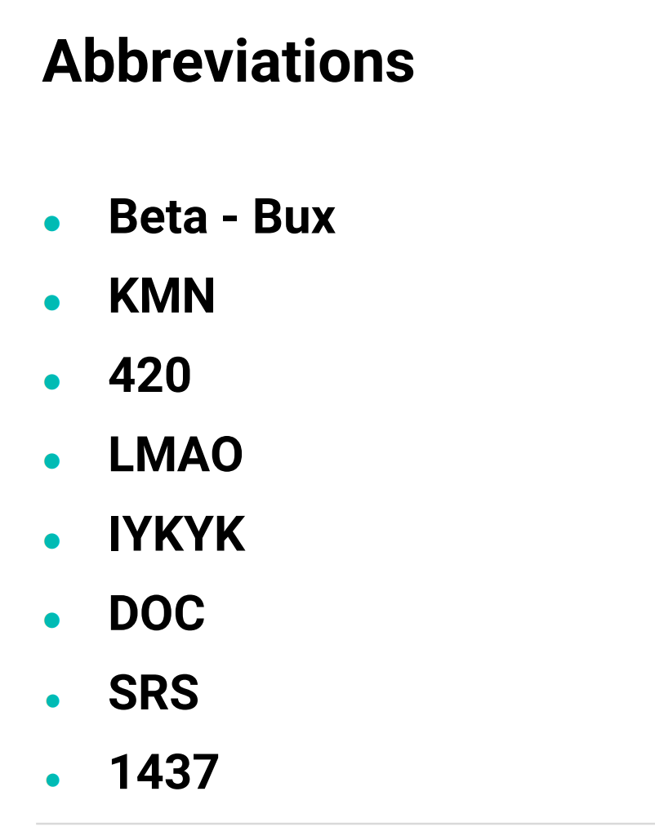

Slide 19
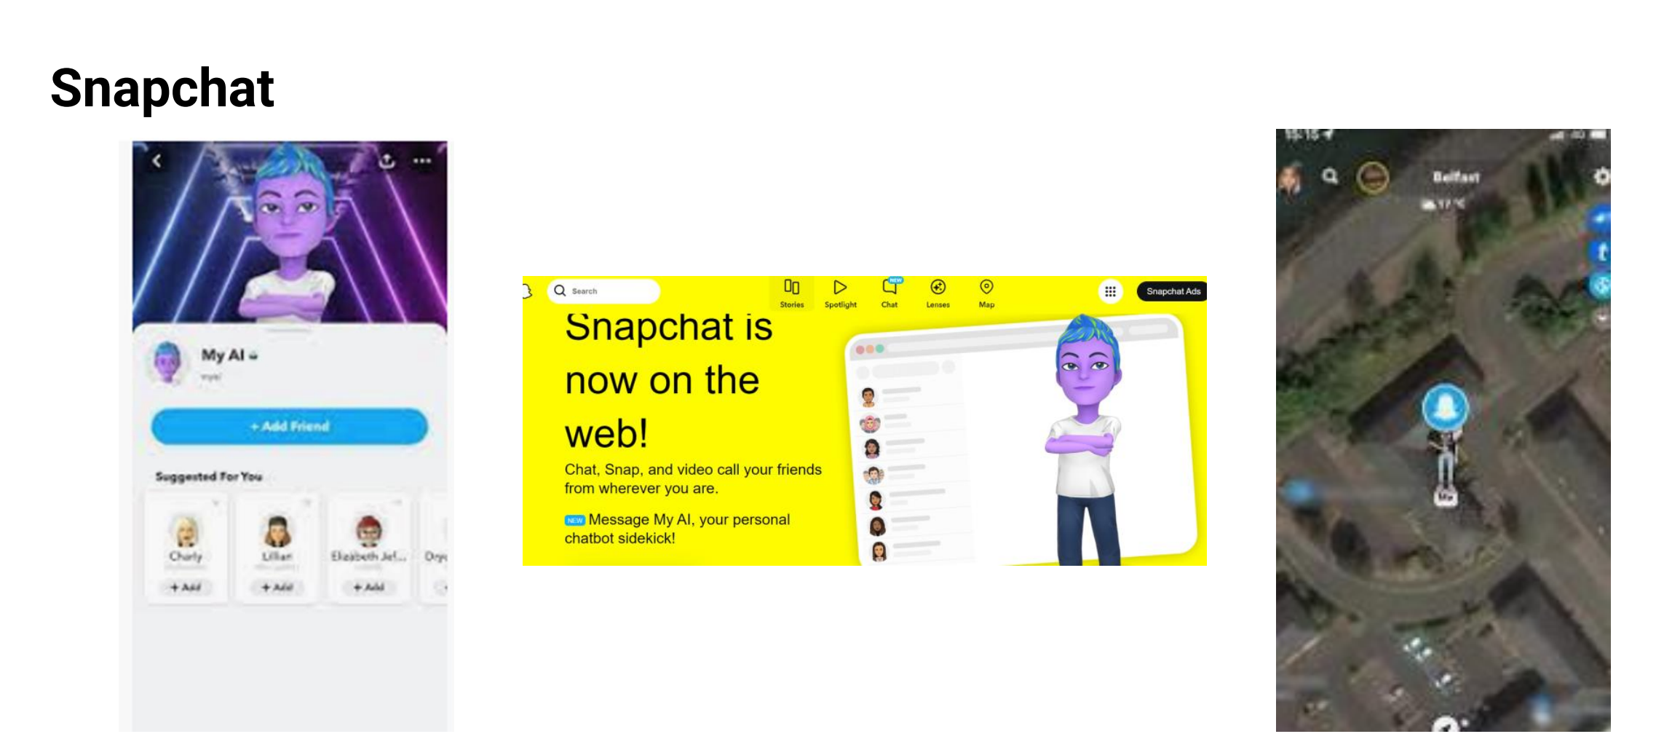
Check location settings.

Slide 20
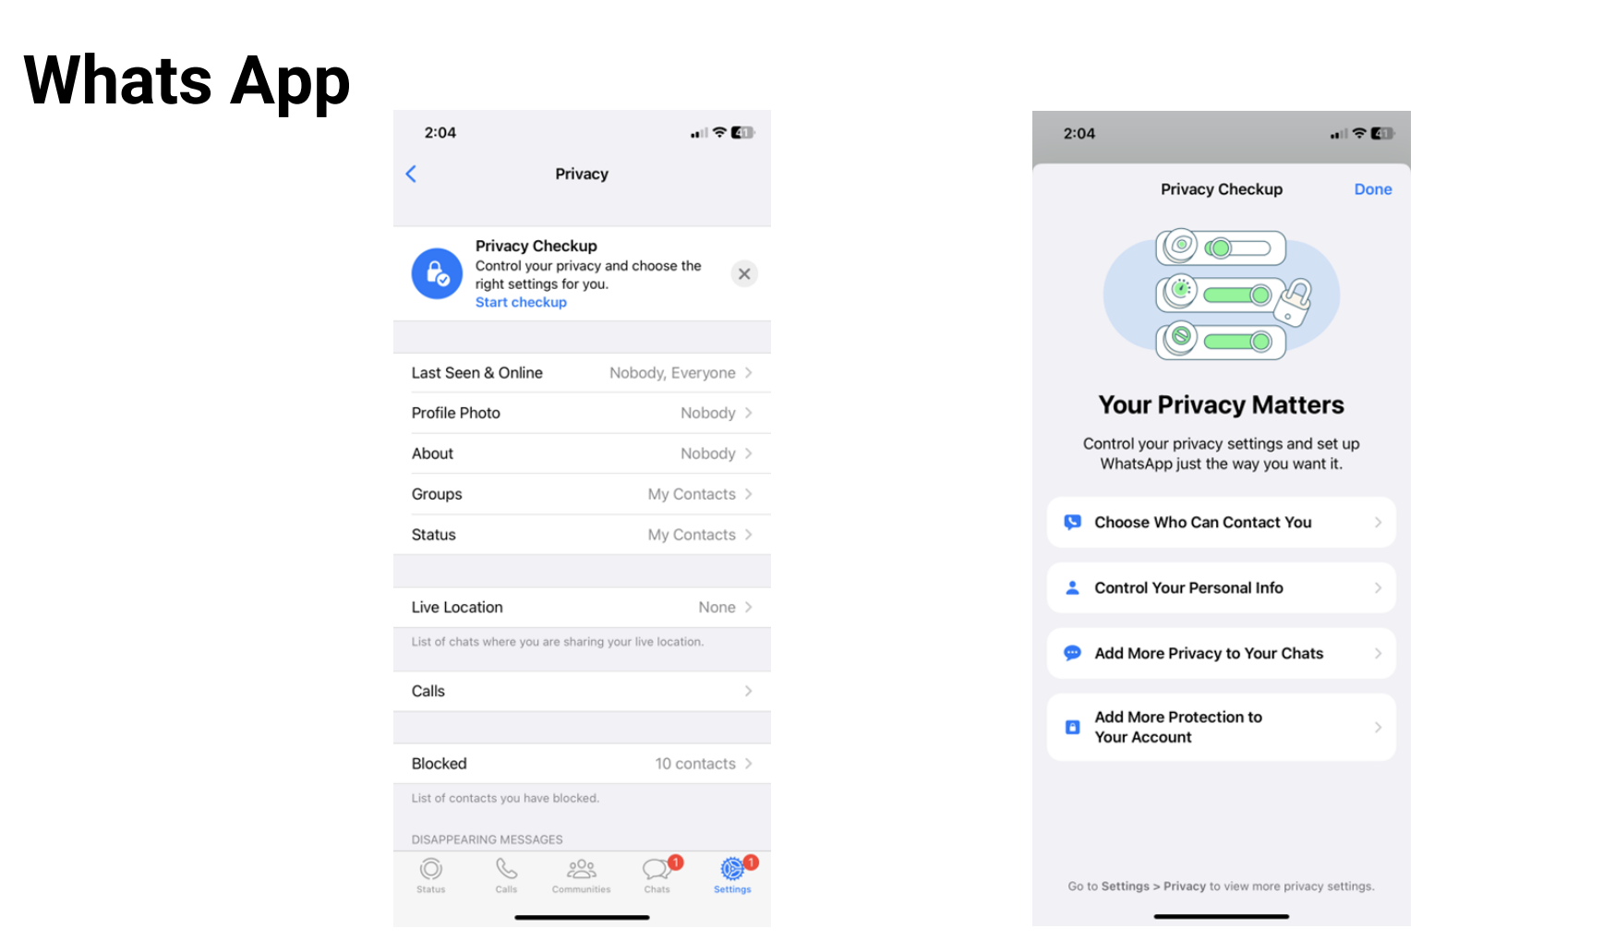
Check location settings
Is WhatsApp Safe for Kids? (youtube.com)

Slide 21
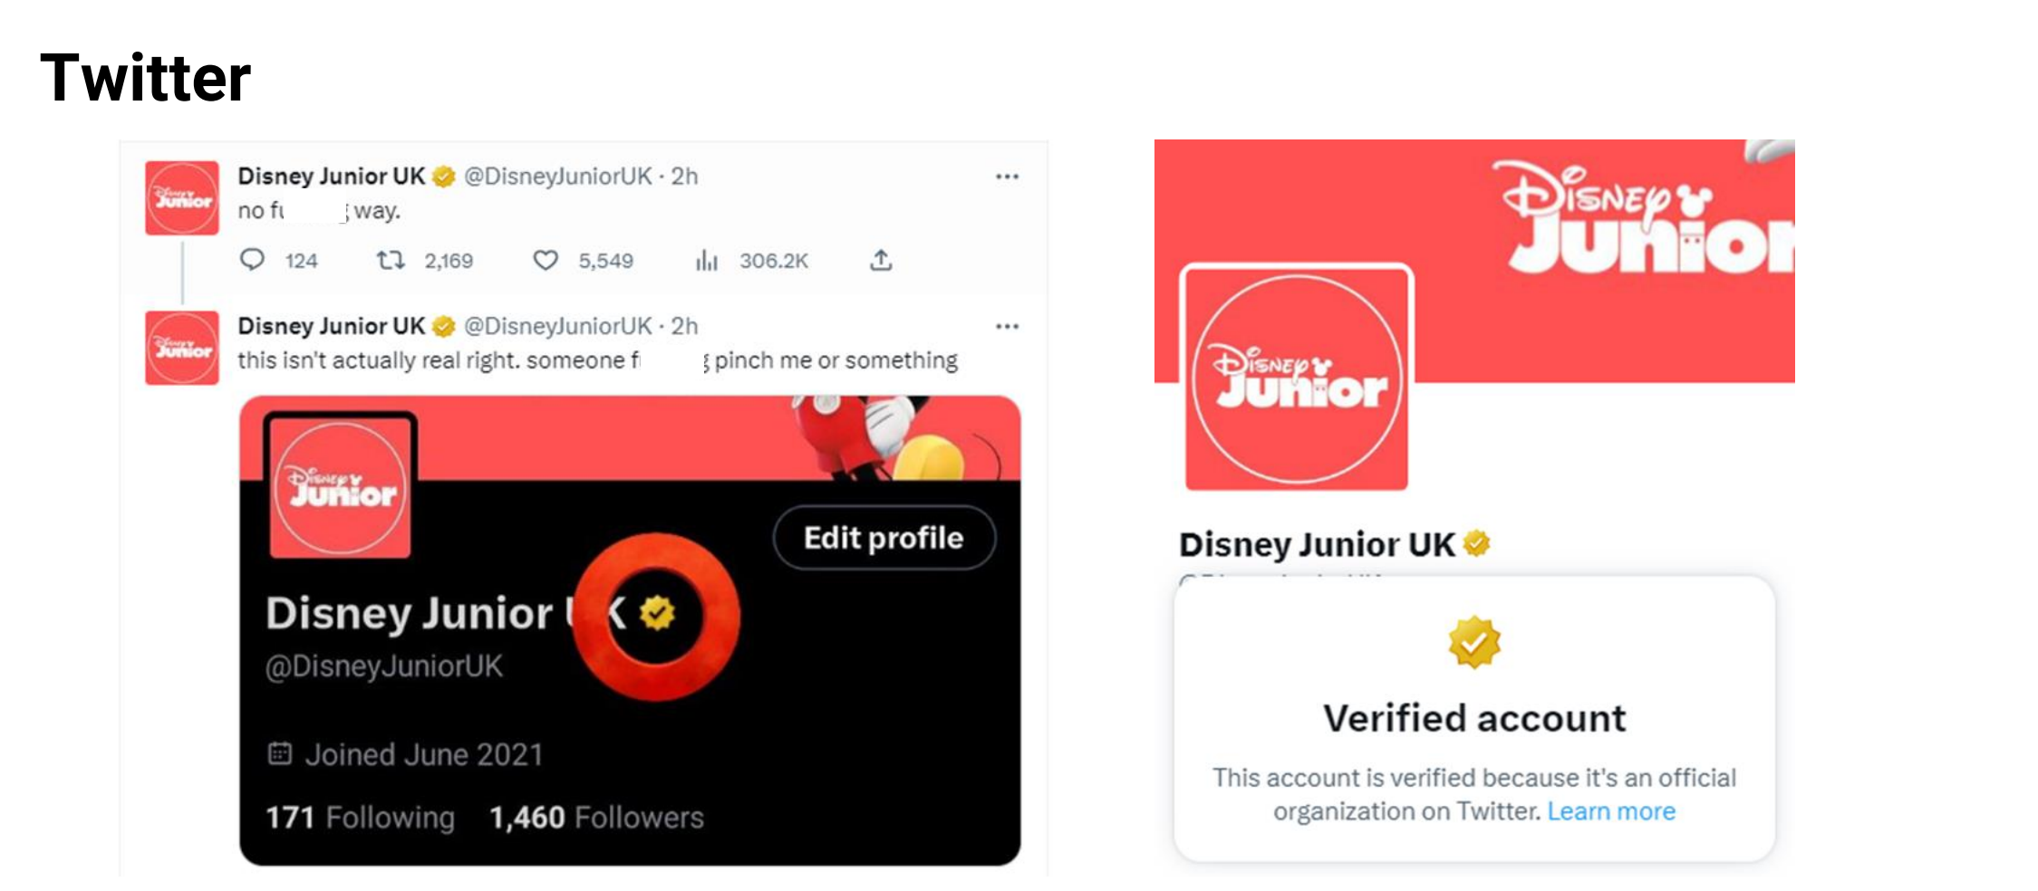
X

Slide 22
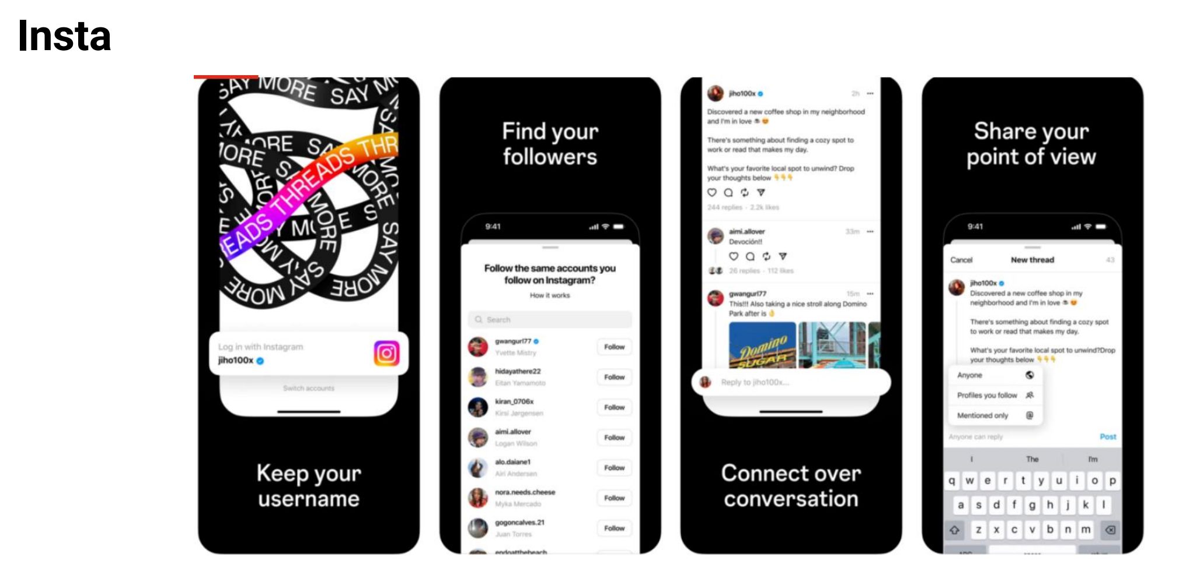
Check privacy settings

Slide 25
Children's digital wellbeing: 2024 report | Internet Matters

